Slide 1
Food and Beverage Management
Facility Design, Layout and Equipment

Slide 2
Planning Process Goals
Negotiations for best prices
Facility appeal
Maximum ROI
Efficient flow of people and product
Safe
Contribute to Food Safety and regulations
Contribute to employee efficiency
Contribute to low maintenance costs
Facility design can make supervision easier

Slide 3
Planning Team
Have a Plan!
Design Team Members-
  GM/Owner, Chef, architect, FOH managers
Develop Concepts
Determine Equipment and space needs
  Work stations
Redesign goals
  Building code and DBPR
Blueprints and specifications

Slide 4
Redesigning the Kitchen
Physical Fatigue
  Reduce distances employees walk
  Heights of work tables
  Employee break and restroom facilities
Noise
Lighting
Temperature
Government Safety Codes

Slide 5
Design Factors
Cost
  Defer project
  Value Engineer
  Borrow or invest more
  Cancel
Menu
  Convenience foods
Food Quantity
  Space
Food Quality
  Batch prep.

Slide 6
Design Factors
Equipment
Utilities
Space
Sanitation and Safety
Type of Service
Banquet

Slide 7
Layouts
Establish Work Flow
L Shaped Layout
Straight Line Layout
U Shape Layout
Parallel Layout

Slide 8
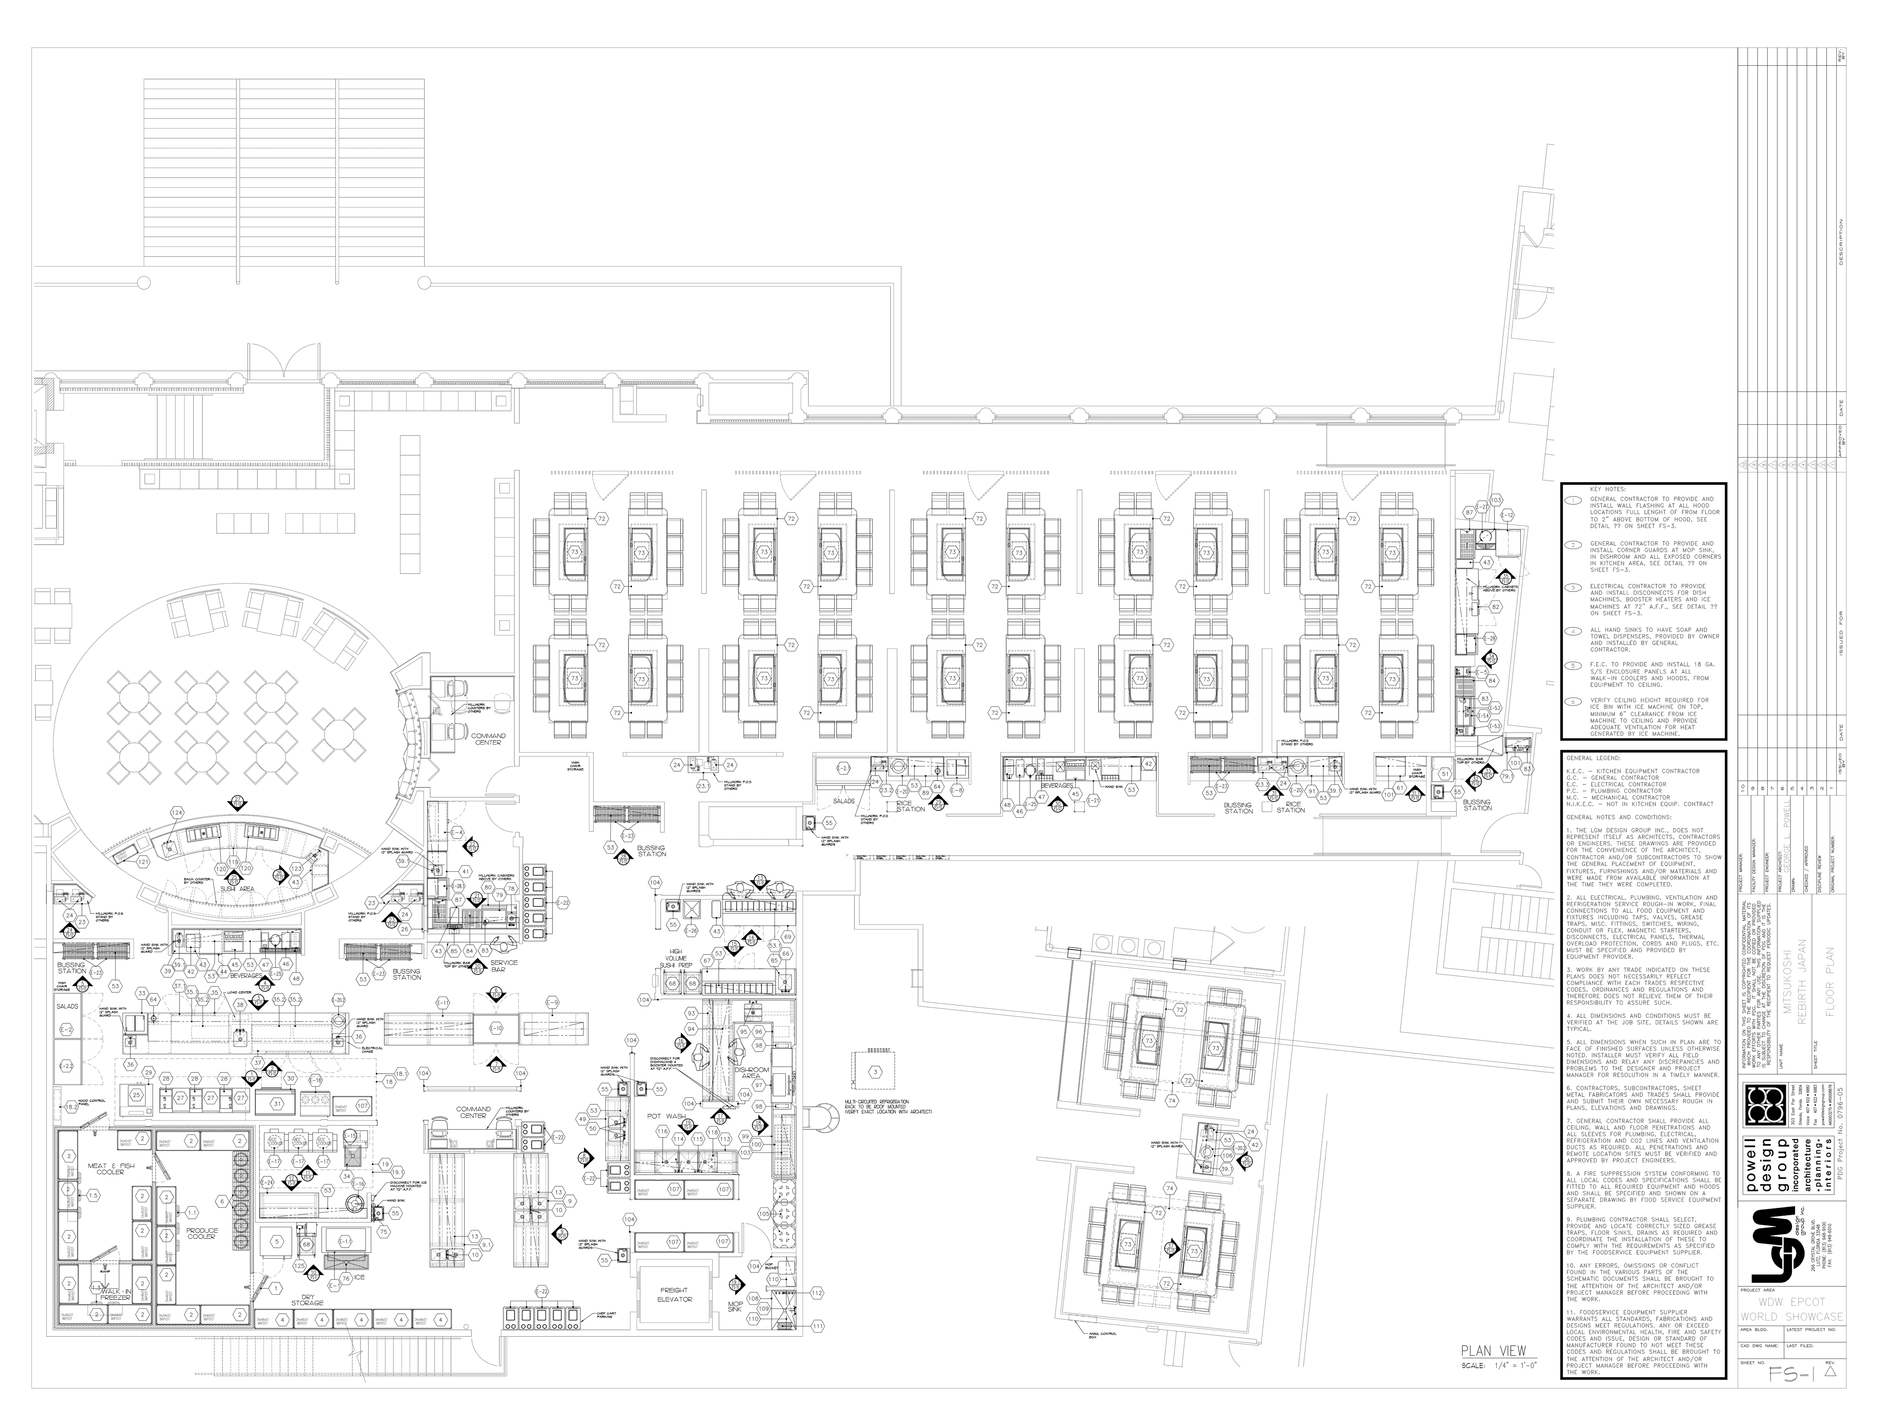

Slide 9
Other Areas
Receiving and Storage
Dining Areas
  Server Supply / Bus Stations
  Cashier work Stations
    Telephone
    Payment Card Terminals
    Retail Items
    Menus
    Dining room sketch with station layout

Slide 10
Bars & Lounges
Servers should not have to transverse Kitchen work areas to get drinks
Guests should not have to go through lounge to get to dining room
3 Types of bars
  Service
  Public
  Combination

Slide 11
Bar Design
Work Efficiency
Bartender should be able to perform related tasks in one place
Sufficient lighting and counters
Doorways and path throughs should be wide enough
Should accommodate employees

Slide 12
Green Restaurant
Solar reflective roofing materials
Rainwater reuse systems
Smart Irrigation
Energy Management Systems
LED lighting
Variable speed demand based ventilation hoods
Energy efficient windows and glazes
Water aerators on sink faucets
Digital Demand Contollers

Slide 13
Food and Beverage Equipment
Factors
Cost
Sanitation and Safety
Design and performance
Operating Efficiency
Capacity
Construction
Other

Slide 14
Equipment
Cost
  Watch financing charges
  Utility costs
Sanitation and Safety
  NSF
  OSHA
  UL & AGA

Slide 15
Equipment
Design and Performance
  Purchase multipurpose equipment
Operating Efficiency
  Energy Star ratings
Maintenance
  Ease of maintenance
  Availability of parts and service

Slide 16
Equipment
Capacity
Construction
  Commercial Grade
Other
  Appearance
  Custom or stock

Slide 17
Types of Equipment
Refrigerators
Ranges
Ovens
Tilting Braising Pans
Steam Cooking Equipment
Broilers
Deep Fryers
Other and Specialty Equipment

Slide 18
Beverage Equipment
Become more advanced –
Beverage Control Units
  Glass sensor
  Guest Check sensor
Empty bottle sensor
Delivery Network
  Sodas – most familiar
  Wine – inert gas delivery systems
  Liquor – house brand systems
  Beer -draft

